Slide 1
Data Structures
ICT-1211
Information and Communication Technology
Lecture-22
Date: //2024

Slide 2
TREES

Slide 3
Linear List and Trees
Linear lists are useful for serially ordered data
  (e1,e2,e3,…,en)
  Days of week
  Months in a year
  Students in a class
Trees are useful for hierarchically ordered data
  Corporate structure
  Government Subdivisions
  Software structure

Slide 4

Real Tree vs Tree Data Structure

Slide 5
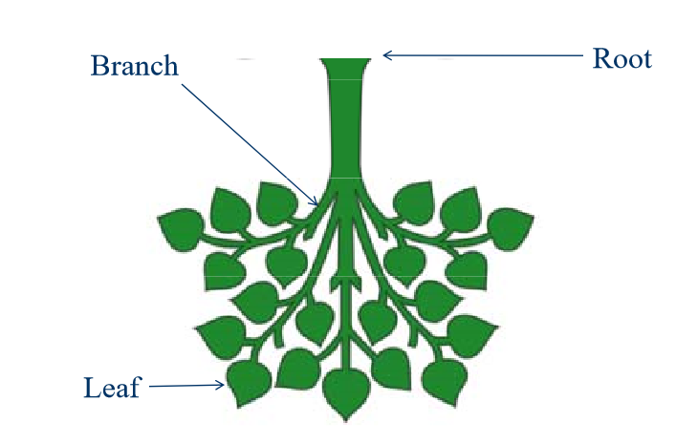
Real Tree vs Tree Data Structure

Slide 6
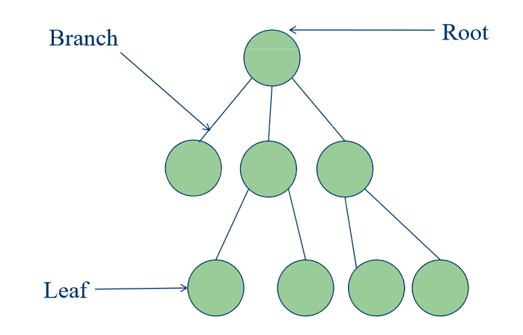
Real Tree vs Tree Data Structure

Slide 7
Definition of Tree
A tree T is a finite nonempty set of elements.
One of these elements is called the root.
The remaining elements, if any, are partitioned into trees which are called the subtrees of T.

Slide 8
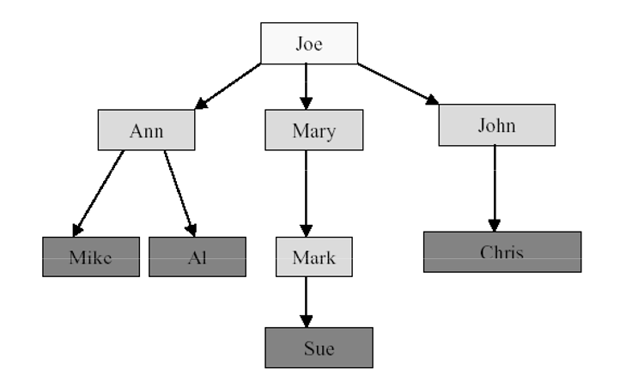
Subtrees

Slide 9
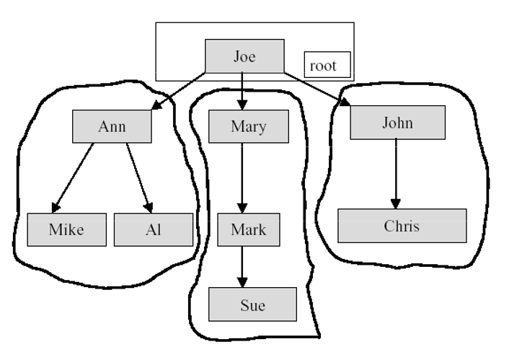
Subtrees

Slide 10
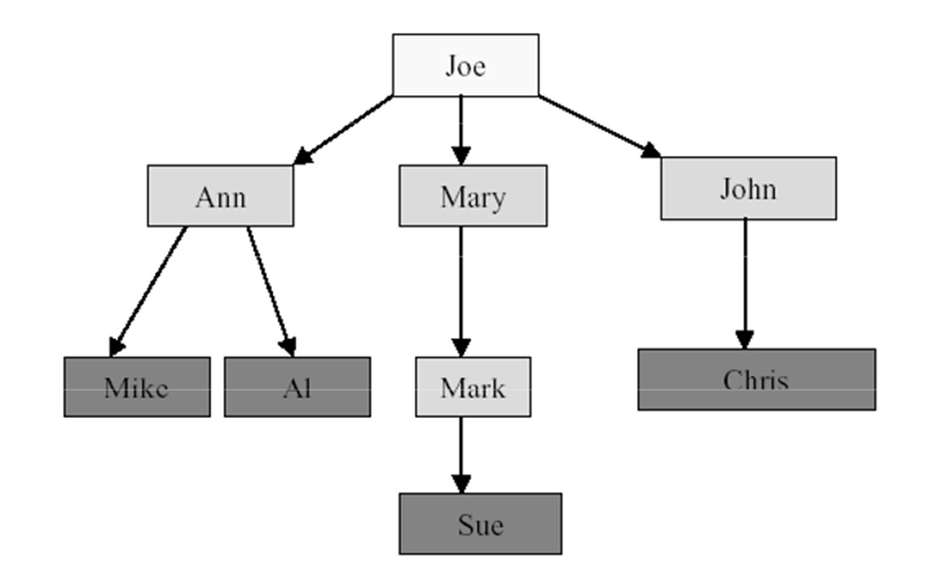
Tree Terminology
The element at the top of the hierarchy is the root.
Elements next in the hierarchy are the children of the root.
Elements next in the hierarchy are the grandchildren of the root, and so on.
Elements at the lowest level of the hierarchy are the leaves.

Slide 11
Other Definitions
Leaves, Parent, Grandparent, Siblings, Ancestors, Descendents
Leaves = {Mike, AI, Sue, Chris}
Parent(Mary) = Joe
Grandparent(Sue) = Mary
Siblings(Mary)={Ann, John}
Ancestors(Mike) = {Ann,Joe}
Descendents(Mary)={Mark,Sue}

Slide 12
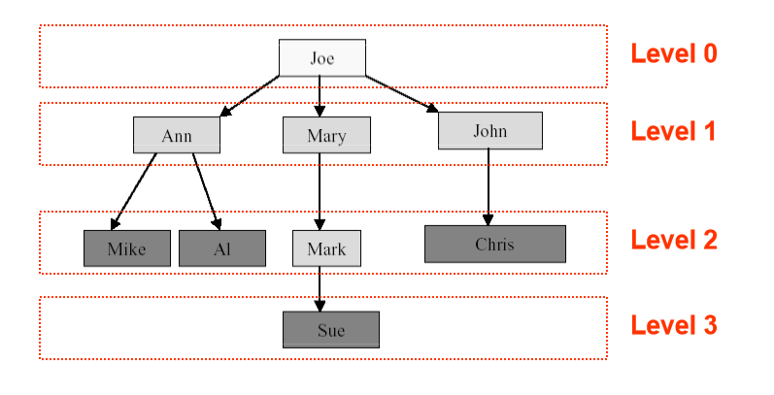
Levels and Height
Root is at level 0 and its children are at level 1.
Height = depth= maximum level index

Slide 13
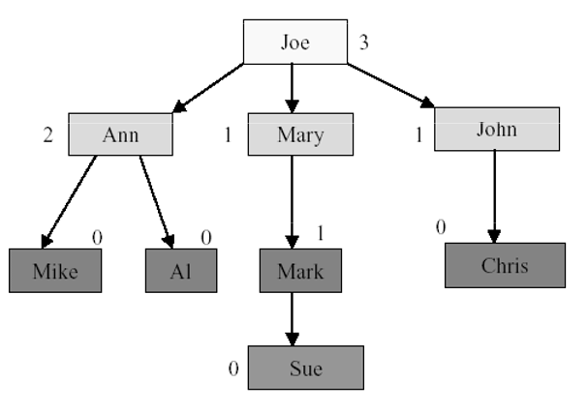
Node Degree
Node degree is the number of children it has.

Slide 14
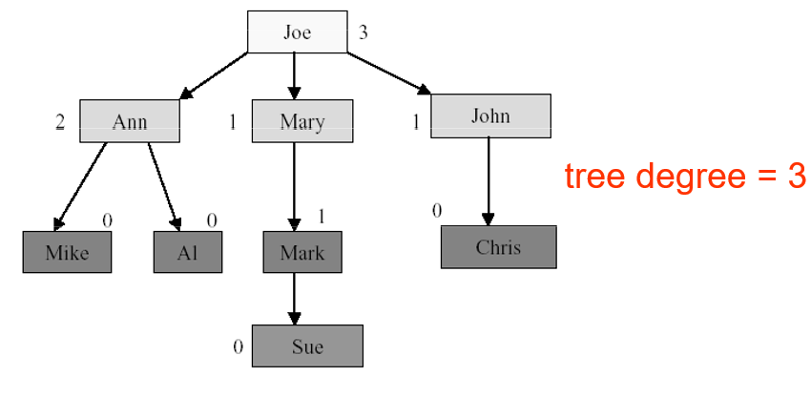
Tree Degree
Tree degree is the maximum of node degrees.

Slide 15
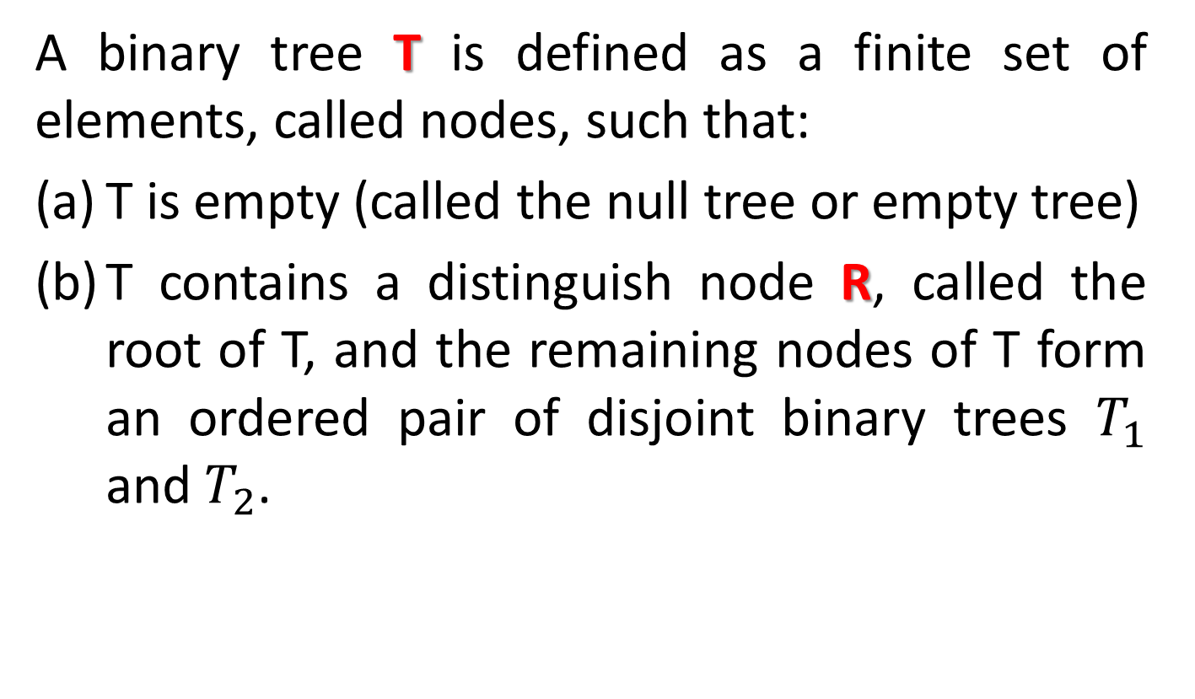
Binary Tree
A binary tree T is defined as a finite set of elements, called nodes, such that:
T is empty (called the null tree or empty tree)
T contains a distinguish node R, called the root of T, and the remaining nodes of T form an ordered pair of disjoint binary trees $T_{1}$ and $T_{2}$.

Slide 16
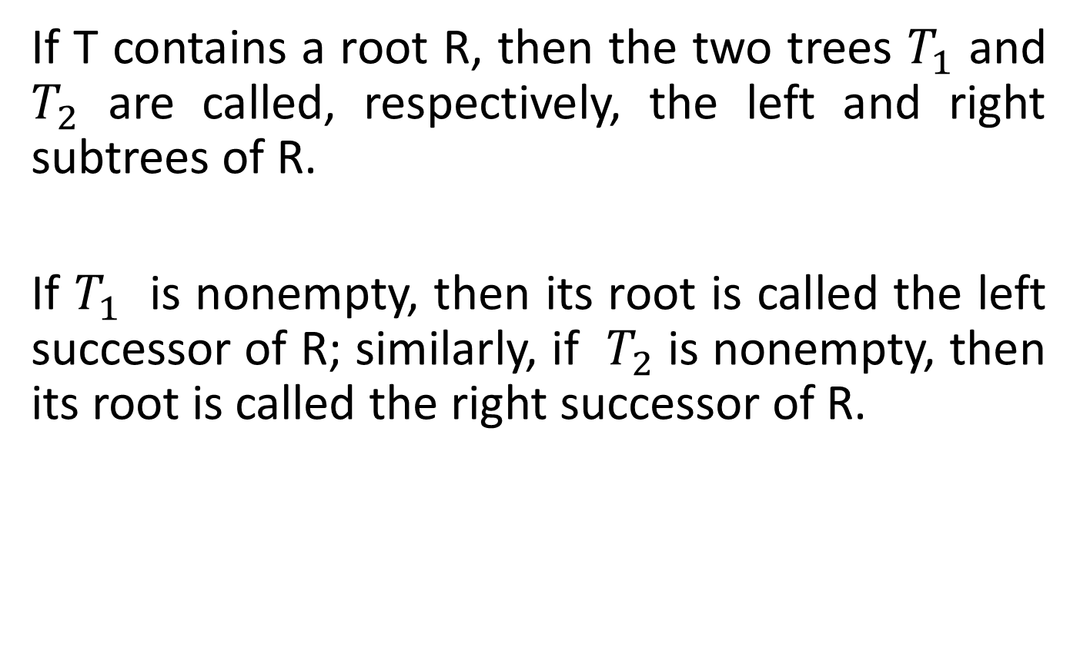
Binary Tree
If T contains a root R, then the two trees $T_{1}$ and $T_{2}$ are called, respectively, the left and right subtrees of R.
If $T_{1}$ is nonempty, then its root is called the left successor of R; similarly, if $T_{2}$ is nonempty, then its root is called the right successor of R.

Slide 17
Binary Tree
The following diagram shows a binary tree T as follows:
A
B C
D E G H
F J K
L

Slide 18
Binary Tree
T consists of 11 nodes, represented by the letters A through L, excluding I.
The root of T is the node A at the top of the diagram.
A left-downward slanted line from a node N indicates a left successor of N, and a right-downward slanted line from a node N indicates a right successor of N.
Here
B is a left successor and C is a right successor of the node A.
The left subtree of the root A consist of the nodes B, D, E and F, and the right subtree of A consists of the nodes C, G, H, J, K and L.

Slide 19
Binary Tree
Any node N in a binary tree T has either 0, 1 or 2
Successors.
The nodes A, B, C and H have 2 successors.
The nodes E and J have only 1 successor.
The nodes D, F, G, L and K have no successors or 0 successor.
The nodes with no successors are called terminal nodes.

Slide 20
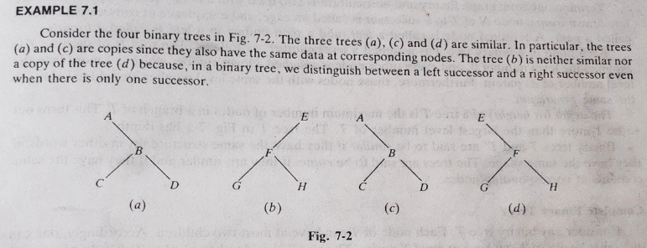
Binary Tree

Slide 21
Binary Tree
Example:
Consider any algebraic expressions E involving only binary operations , such as
E = ( a – b ) / ( ( c * d ) + e ) )
Solutions:
/
- +
a b * e
c d

Slide 22
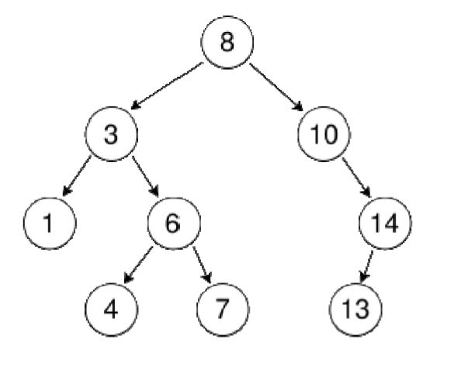
Binary Tree: Example

Slide 23
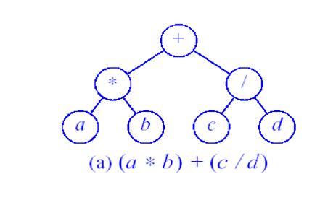
Binary Tree: Expression

Slide 24
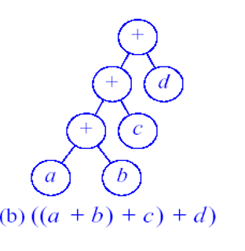
Binary Tree: Expression

Slide 25
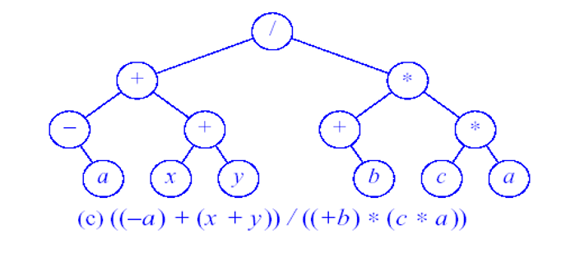
Binary Tree: Expression

Slide 26
Thank you……

